Slide 1
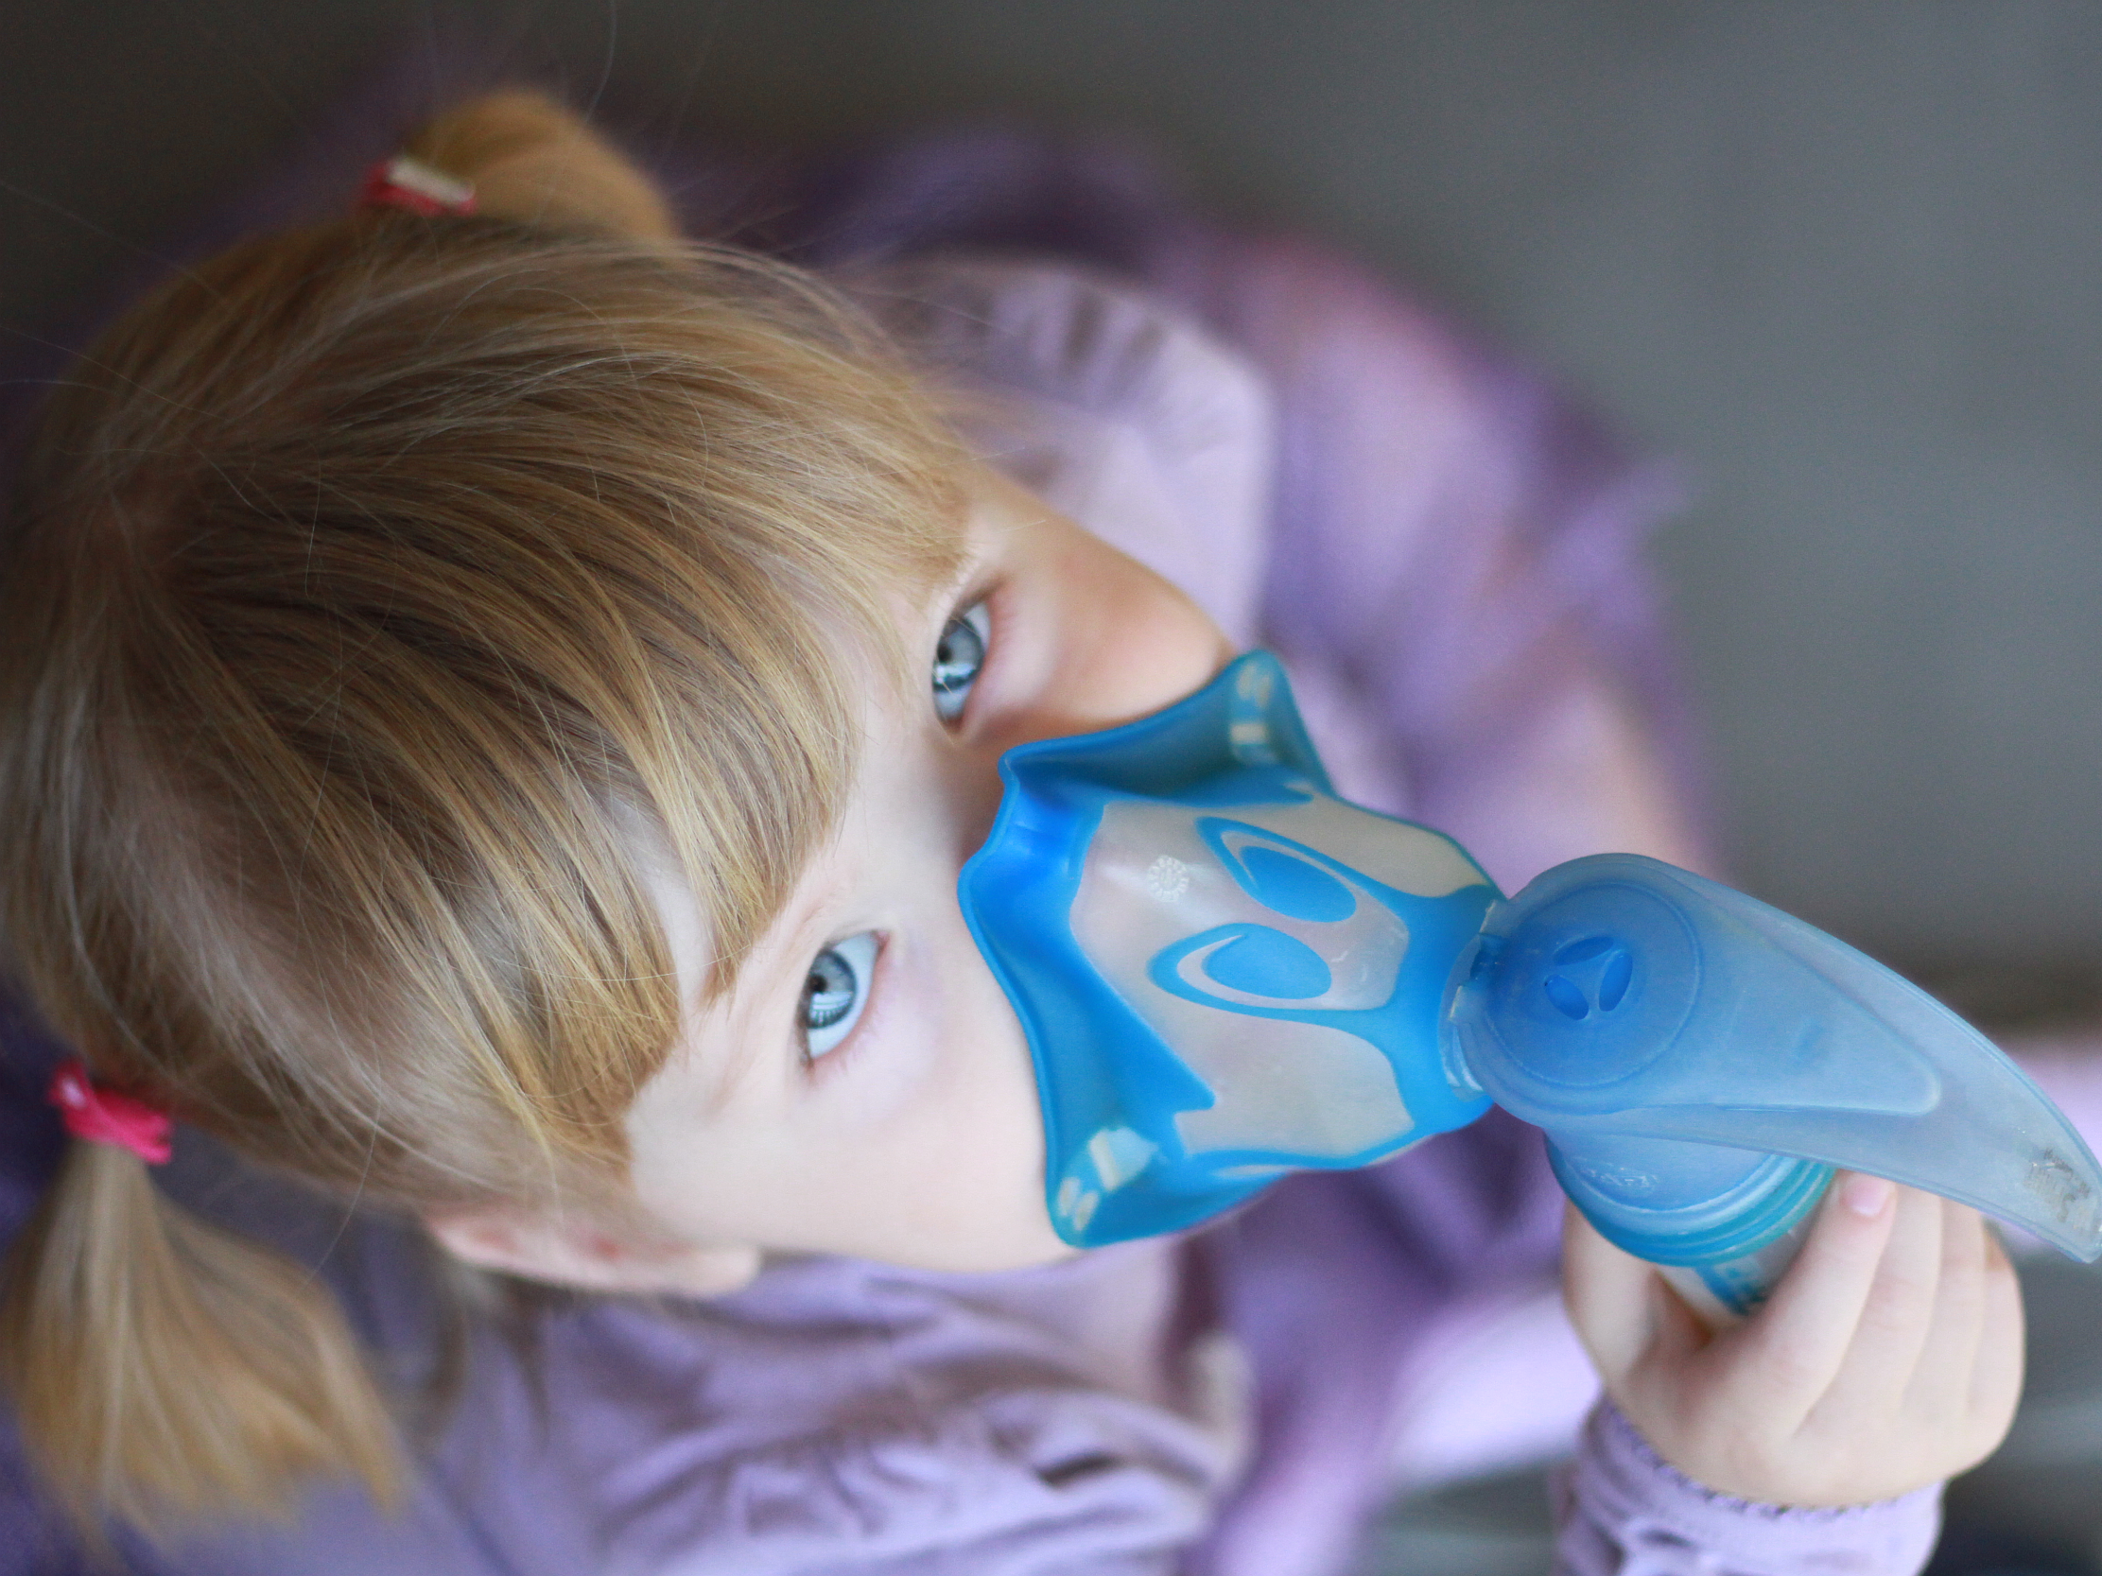

Polish Society
For the Fight Against
Cystic Fibrosis

Slide 2
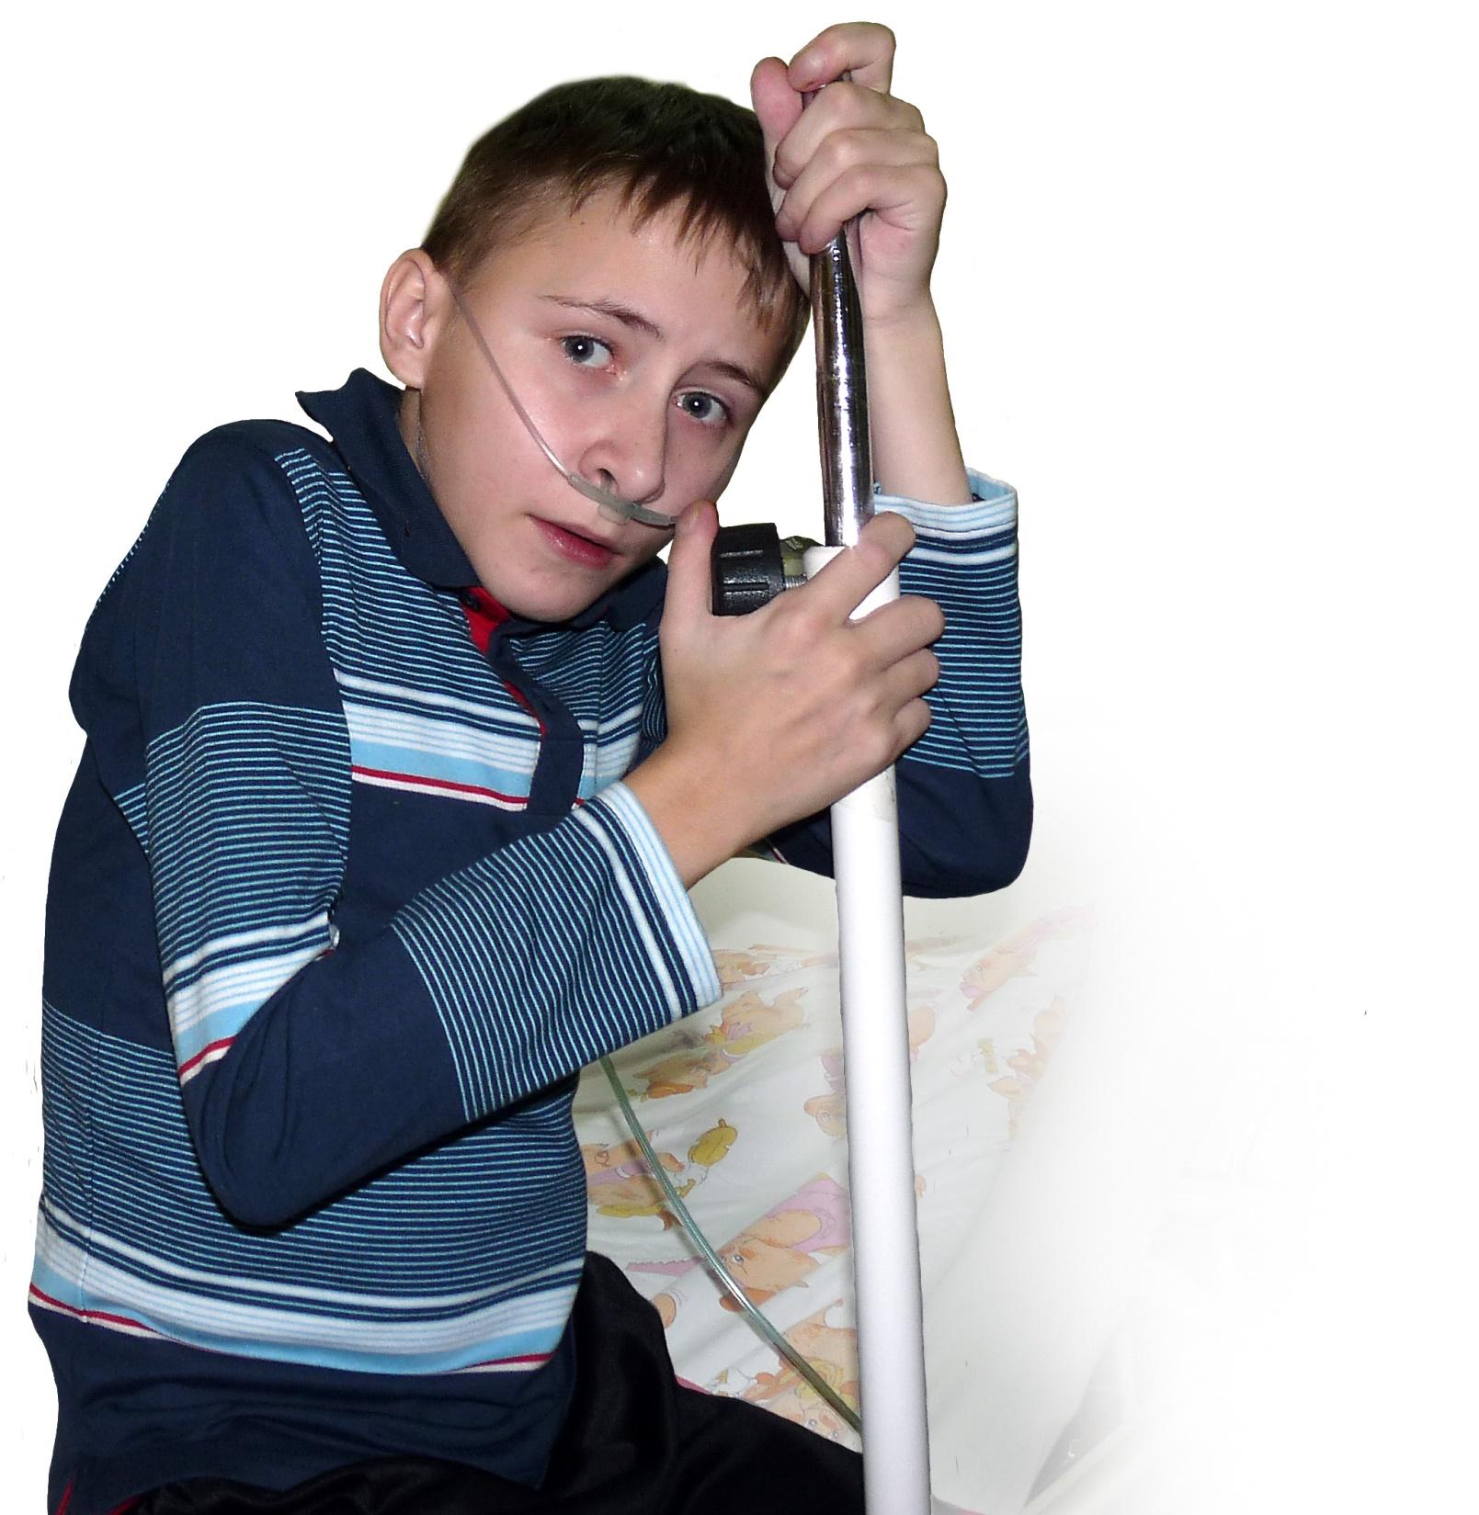
CF population
in Poland
ca 2000 patients
children (0-18 yrs) 65.5%
adults (>18 yrs) 34.5%

Slide 3
How has CF patient reality changed in Poland?
The median age at death of Polish CF patients
USA – 27.5
UK – 29
Kanada – 32
2006 lung transplants
2006 colistin
2005 ECFS Standards
1994 Pulmozyme
1987 PTWM
Deceased children
97.4%
Deceased children
96.7%
Deceased children
89.7%
Deceased children
38.6%
Deceased children
25.6%
Source: OT IGICHP Rabka-Zdrój 1970-2014 – Dr Andrzej Pogorzelski

Slide 4
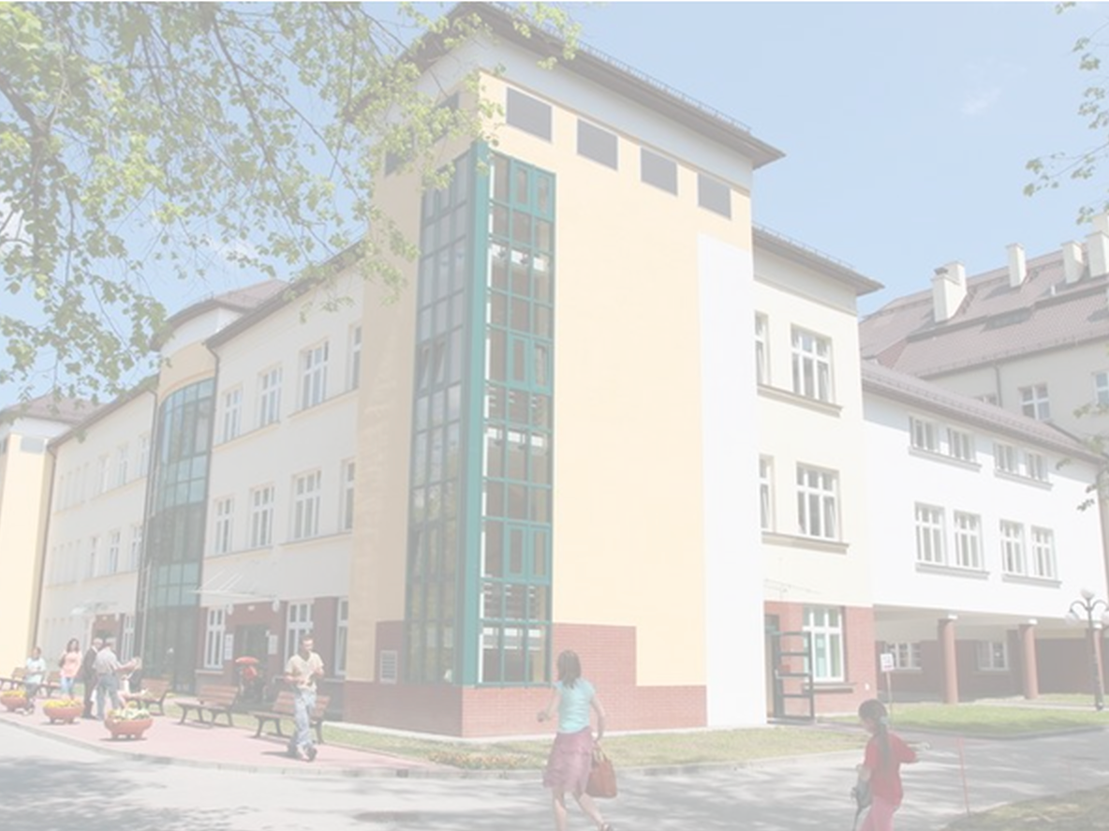
Polish Society
For the Fight Against
Cystic Fibrosis (PTWM)
Who are we?
A CF patient community gathering over 1700 CF patients.
We 30 years’ experience helping CF patients in Poland. We currently operate in three locations: CF Centre in Rabka-Zdroj, CF Centre in Dziekanów Leśny (near Warsaw), a PTWM branch office in Gdańsk.
Our mission is to support all the patients, both children and adults, in the whole country in their fight with the disease.

Slide 5
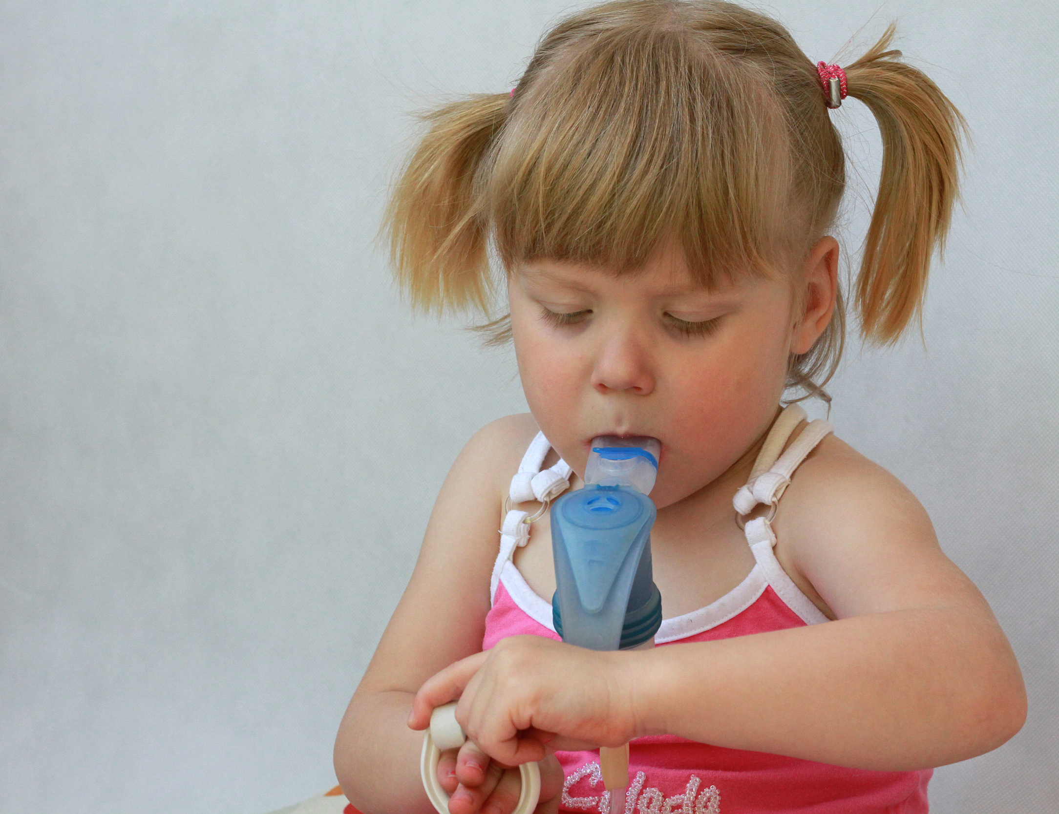
We organise home rehabilitation
Thanks to the state-funded grants, we arrange regular home visits by CF-qualified physiotherapists.
Currently we offer home care for 200 patients
We operate a charge-free rehabilitation device rental facility
Since 2006 we have been renting rehabilitation devices free of charge, including respiratory clearance, disinfection, and oxygen therapy devices.

Slide 6

We help patients to cover costs of treatment
We educate patients about fundraising and administrate the funds raised by the patients from charity and from the 1% income tax allocation scheme.
Direct financial help for the patients
The society provides financial grants for the most necessitous patients.

Slide 7
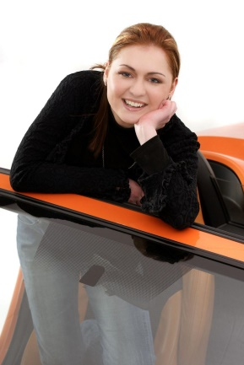
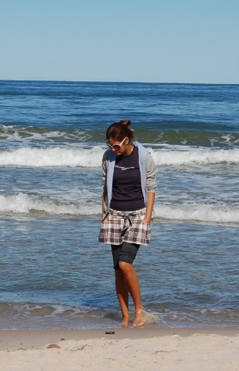
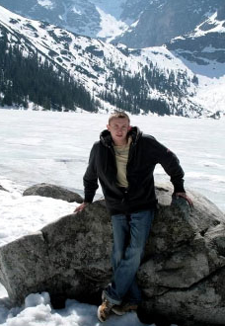
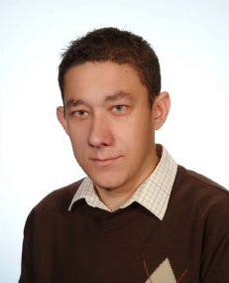
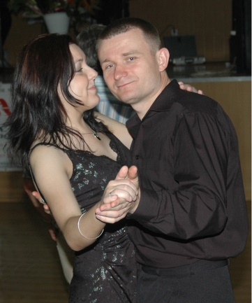
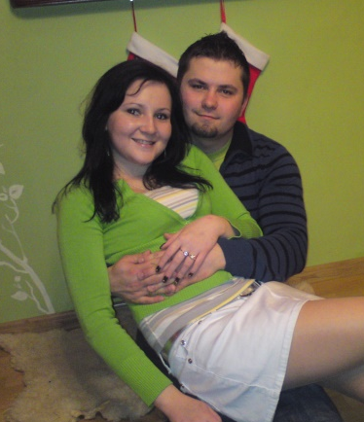
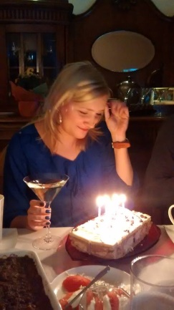
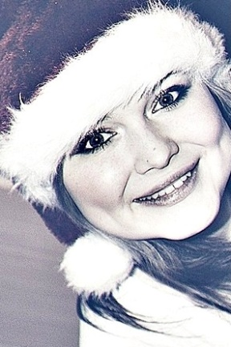
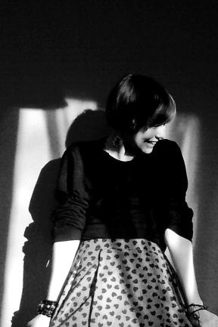
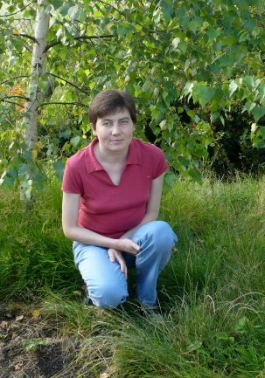
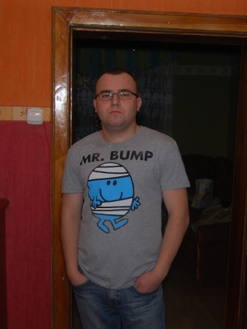
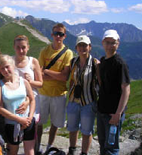
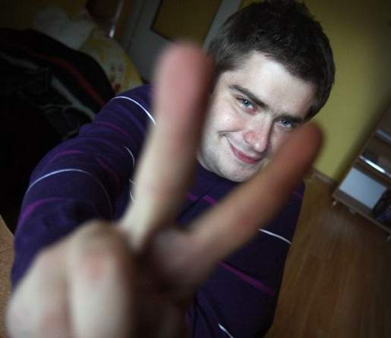
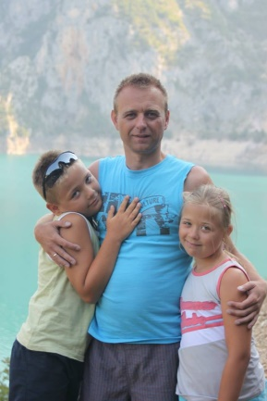
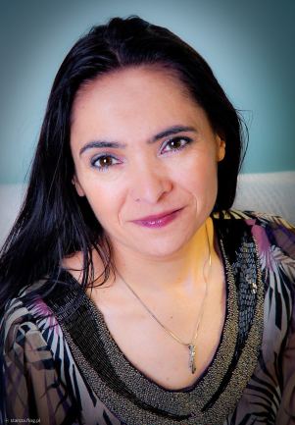
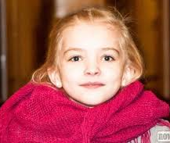
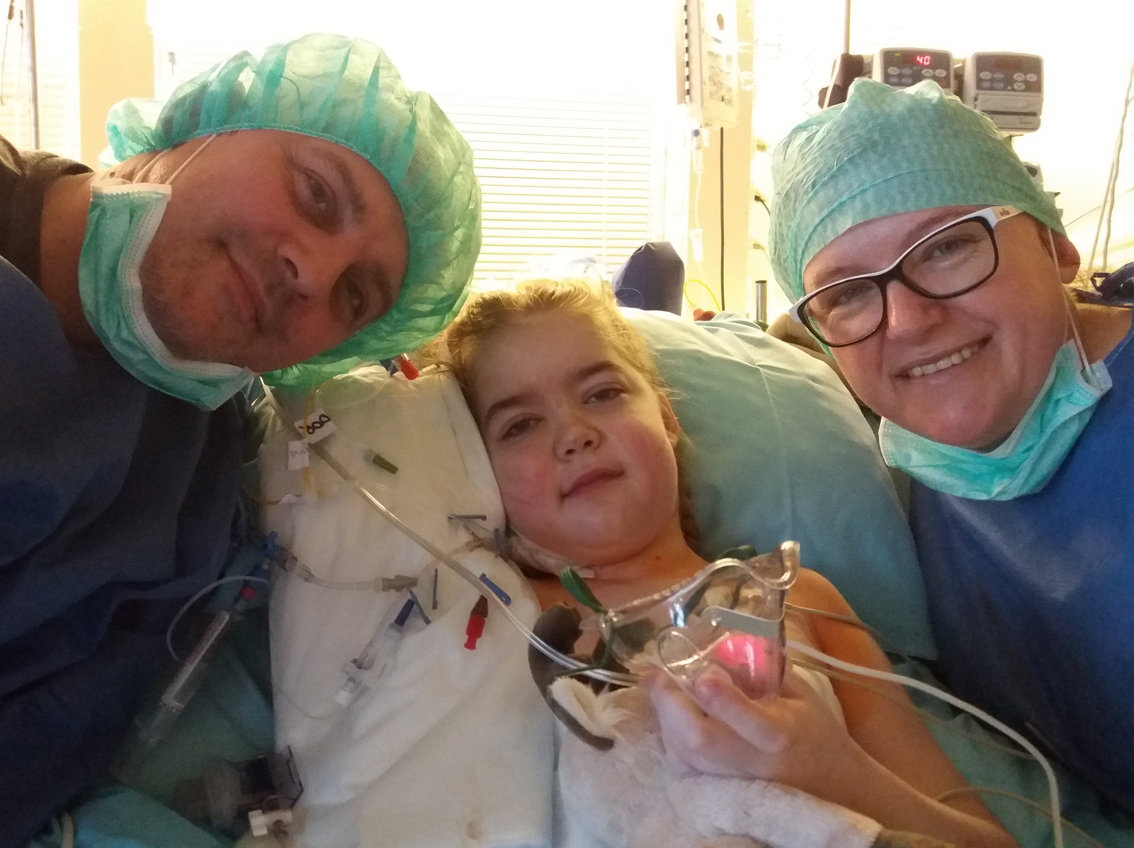
Since 2006 we have been arranging lung transplantations in AKH Vienna for Polish patients. The transplants were financed by private sponsors.

Slide 8
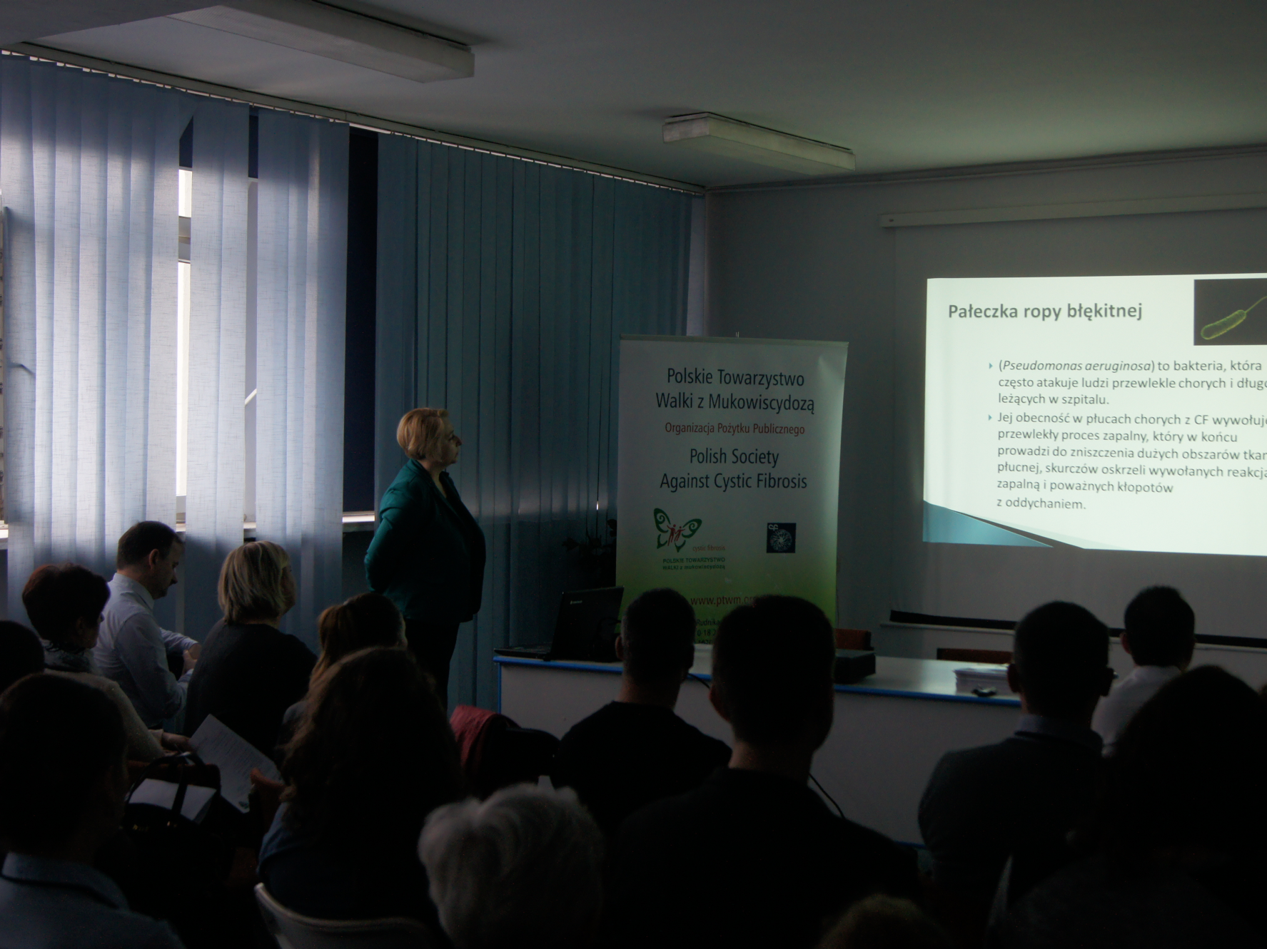
We organise conferences, workshops, and webinars for the parents, physiotherapists, dieticians and nurses
A toll-free helpline and social support guidance in Rabka-Zdroj, Dziekanow Leśny and Gdańsk
Patients receive free suport and guidance from social workers, lawyers, dieticians, physiotherapists and CF nurses

Slide 9
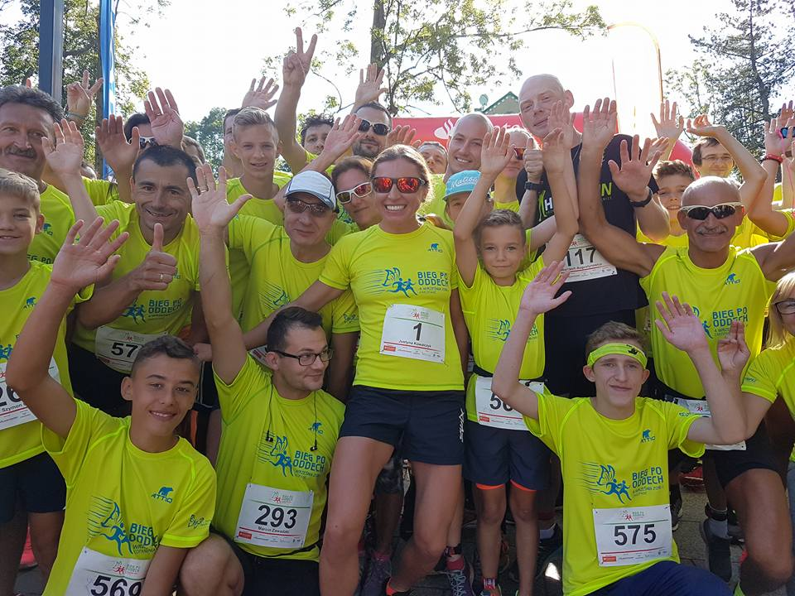
We organise social campaigns and charity events
A major sports event – Run for Breath in Zakopane
(a charity 5 km run for 700 runners)

Slide 10
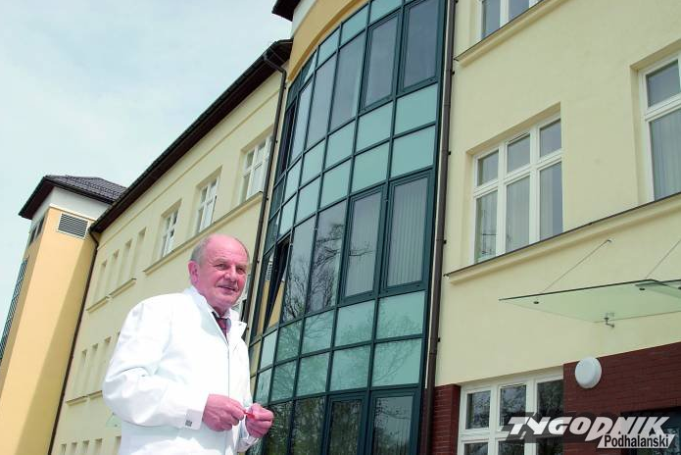
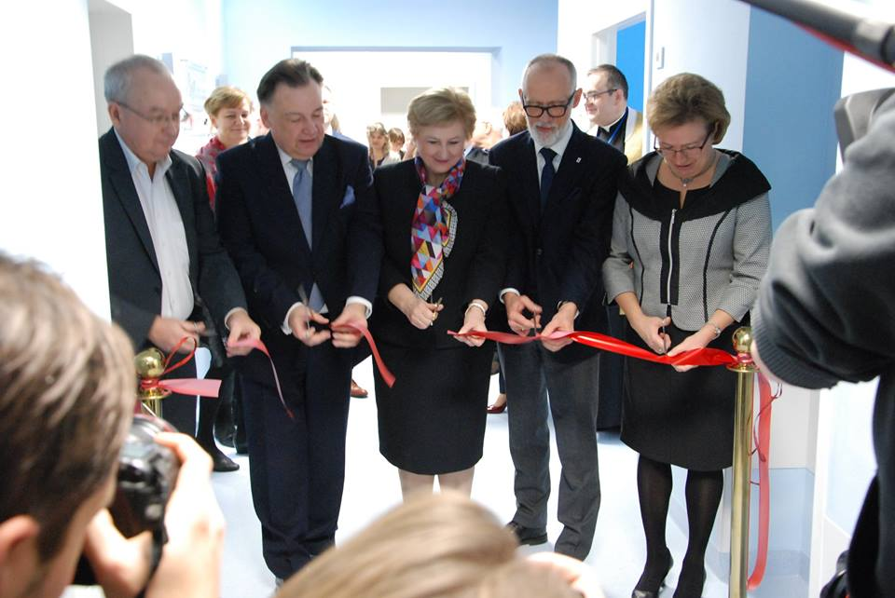
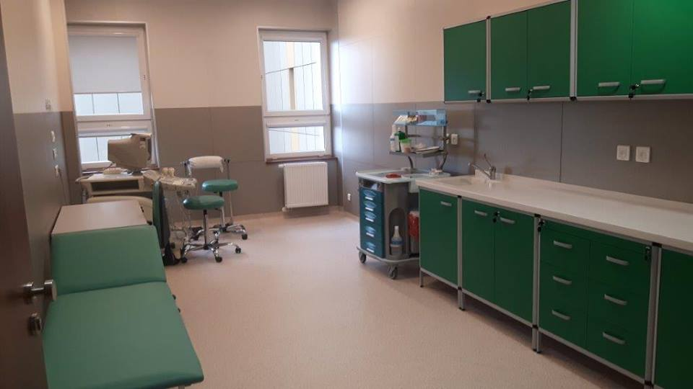
We support CF centres
2012/2013 we purchased equipment for the CF Centre in Rabka-Zdrój
2015/2016 the partnership in establishing the most modern paediatric CF Centre in Dziekanów Leśny near Warsaw
2015/2016 the partnership in establishing an adult CF Centre in Sosnowiec
2017 the partnership in the remodelling of the adult CF centre in Poznań

Slide 11
What we strive for?
To introduce European standards of care in Poland
Transplants
State-of-the-art medications
Improvement of the CF centres infrastructure
Better patient isolation
Better access to multidisciplinary CF care
in specialised CF centres
Early diagnosis – newborn screening

Slide 12
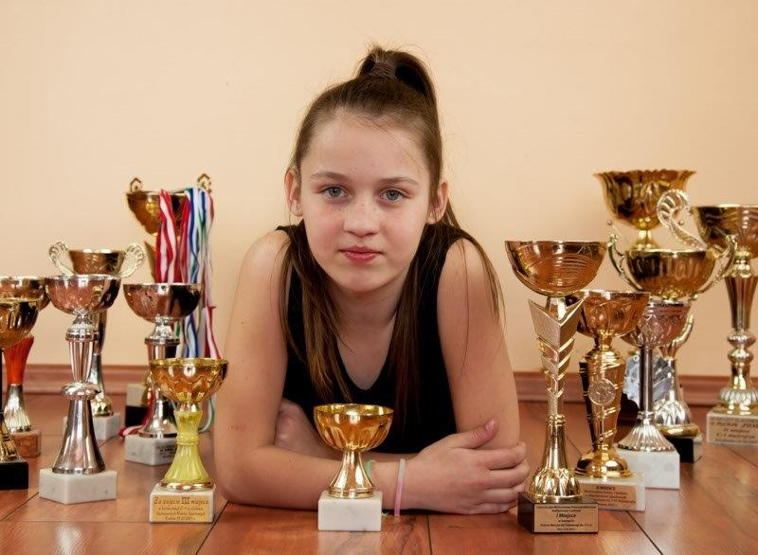
Thank you for your attention ☺

